Slide 1
DEVELOPMENT OF AUTOMATED TYRE INFLATION SYSTEM
PROJECT STAGE- 2
PROJECT BY:
Ramakrishna M G (19261A0376)
Lohith P (19261A0375)
Sharath Chandra U (19261A0385)
Satya prasad Reddy P(19261A0373)
Project Guide:
B.V. Hima Sekhar Sai
assistant professor ,MGIT

Slide 2
AIM OF THE PROJECT
This system has three general goals:
a)TO DETECT: -If the air pressure in tyre has dropped (Continuously check the air pressure in each tyre).
b) TO NOTIFY: -If there is any dropped in the air pressure in any tyre.
c)TO INFLATE DEFLATER -In case of over pressure or under pressure the tyre pressure is maintained inflate the tyre to the required level if there is a drop in the tyre pressure and there has to be an air supply as well as check wall that opens only when needed

Slide 3
ABSTRACT
This project aims to develop an automatic, self-inflating tire system. Such a system ensures that tires are properly inflated at all times. The compressor will supply air to all tyres via hoses and a rotary joint fixed between the wheel spindle and wheel hub at each wheel. The Rotary joint is an integral component of the system which has half of its part rotating with the wheel and the rest of the half part is stationary. Considering today’s fast-growing environmental threats, oil price hikes and energy consumption, this system is most compatible and has potential improvement in mileage and tyre wear reduction which leads to an increase in the performance of the tyres in diverse conditions. This project aims to stabilize all automobile tires with ideal pressure, make the system automated, achieve satisfactory fuel efficiency, construct an affordable system, increase tire life and reduce accident rate by installing the system in vehicles.

Slide 4
Objectives :
The Main objectives of the Project are to ,
Extended tire life due to proper tire inflation.
Increase fuel efficiency.
Create Variation and Optimization of tire pressure according to road conditions with reduced manual effort.
Improve vehicle stability and reduce the risk of accidents.
Obtain low maintenance cost and Enhanced Environmental performance.

Slide 5
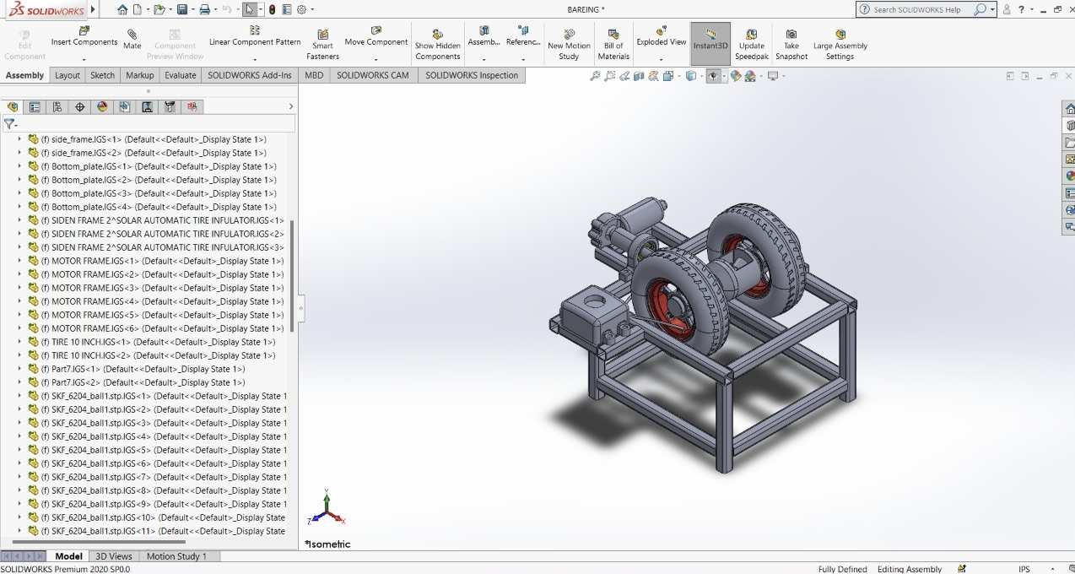
☞PROJECT MODEL DIAGRAM

Slide 6
Components required
A) AIR COMPRESSOR :
An air compressor is a device that convert power(using an electric motor, diesel or gasoline engine, etc.) into potential energy in pressurised air. By one of serval methods, an air compressor forces more and more air into a storage tank, increasing the pressure. From tank compressed air is sent to wheels.
B) FLEXIBLE AIR HOSE :
It is kind of hollow tube which is used to transport air from the compressor to the tyre and it is flexible due to which it can easily transport.
C) ELECTRIC MOTOR WITH GEAR BOX :
Direct current electrical energy into mechanical energy. 12V DC square gear / geared motor 10 rpm - high torque. Gear box is built to handle the stall torque produced by the motor.Driver shaft is supposed form with metal bushes to give strength.

Slide 7
D)SOLENOID VALVE :
A solenoid valve is an electrically controlled valve. The valve features a solenoid, which is an electric coil with a movable ferromagnetic core (plunger) in its center. In the rest position, the plunger closes off a small orifice. An electric current through the coil creates a magnetic field. The magnetic field exerts an upwards force on the plunger opening the orifice. This is the basic principle that is used to open and close solenoid valves
E) QUICK RELEASE COUPLING :
A quick connect fitting, also called a quick disconnect or quick release coupling is a coupling used to provide a fast, make-or-break connection of fluid transfer lines. Operated by hand, quick connect fittings replace threaded or flanged connections, which require wrenches. When equipped with self-sealing valves, quick connect fittings will, upon disconnection, automatically contain any fluid in the line.

Slide 8
F) ROTARY JOINT :
A rotary union or swivel joint is a mechanism used to transfer fluid (under pressure or vacuum) from a stationary inlet to a rotating outlet, preserving and isolating the fluid connection.
G) PRESSURE SENSOR :
Pressure transducers have a sensing element of constant area and respond to force applied to this area by fluid pressure. The force applied will deflect the diaphragm inside the pressure transducer. The deflection of the internal diaphragm is measured and converted into an electrical output. This allows the pressure to be monitored by microprocessors, programmable controllers and computers along with similar electronic instruments

Slide 9
H) WHEEL AND TIRE :
It is a circular component that is intended to rotate on an axle bearing.Tires are mounted onto wheels that most often have integral rims on their outer edges to hold the tire. Automotive wheels are typically made from pressed and welded steel, or a composite of lightweight metal alloys, such as aluminum or magnesium.
I) AXLE :
An axle is a central shaft for a rotating wheel or gear. On wheeled vehicles, the axle may be fixed to the wheels, rotating with them, or fixed to the vehicle, with the wheels rotating around the axle In the former case, bearings or bushings are provided at the mounting points where the axle is supported.

Slide 10
J) ARDUINO :
Arduino consists of both a physical programmable circuit board (often referred to as a microcontroller) and a piece of software, or IDE (Integrated Development Environment) that runs on your computer, used to write and upload computer code to the physical board.
K) TWO CHANNEL RELAY :
2-Channel 5V Relay Module is a relay interface board, it can be controlled directly by a wide range of microcontrollers such as Arduino, AVR, PIC, ARM and so on. It uses a low level triggered control signal (3.3-5VDC) to control the relay. Triggering the relay operates the normally open or normally closed contacts.

Slide 11
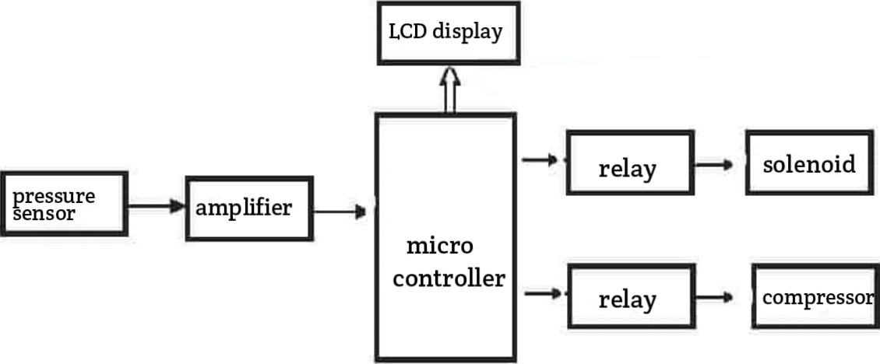
Block Diagram
BLOCK DIAGRAM

Slide 12
PROGRAM ALGORITHM

Slide 13
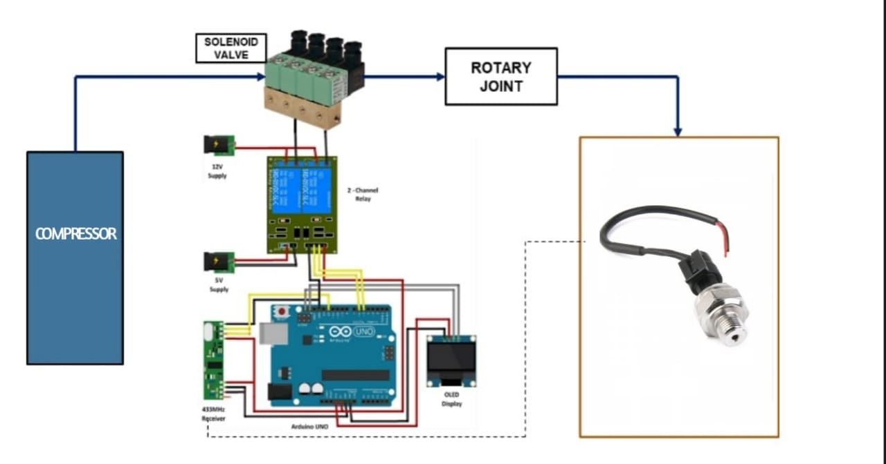
Circuit Diagram

Slide 14
Summary of the work carried out :
An automated tire inflation system requires the assembly and integration of various components such as frame, wheels, shaft, pneumatic hose, compressor, solenoid, pressure sensor, microcontroller, LCD, driver board, battery, regulated power supply section, 2 channel relay, and push button.
The system uses a mild steel frame for support, wheels attached to a shaft powered by a motor, and a pneumatic hose for air pressure control.
The compressor is responsible for compressing air, the solenoid controls air flow, and the pressure sensor measures tire pressure.
The microcontroller acts as the system's brain, processing data and controlling functions, with the LCD providing real-time tire pressure information.
The system can be programmed to work in different modes with varying air pressures, and the controller will automatically adjust the tire pressure as required.

Slide 15
CONCLUSIONS
The Automated tire inflation system helps in attaining
Improved Fuel efficiency
To Control tire pressure according to driving condition and even the road surface the vehicle is travelling.
Provides better traction force between the tire and the road surface
Less tire wear
Improved tire maintenance
Better wheel stability

Slide 16

Future scope
The future scope of automated tire inflation systems lies in advancing technologies such as machine learning and Internet of Things (IoT) integration.
These systems can be further enhanced with real-time data analysis, predictive maintenance capabilities, and remote monitoring.
Additionally, exploring integration with autonomous vehicles and developing smart tire technologies will open up new possibilities for improved safety, efficiency, and sustainability in transportation.

Slide 17
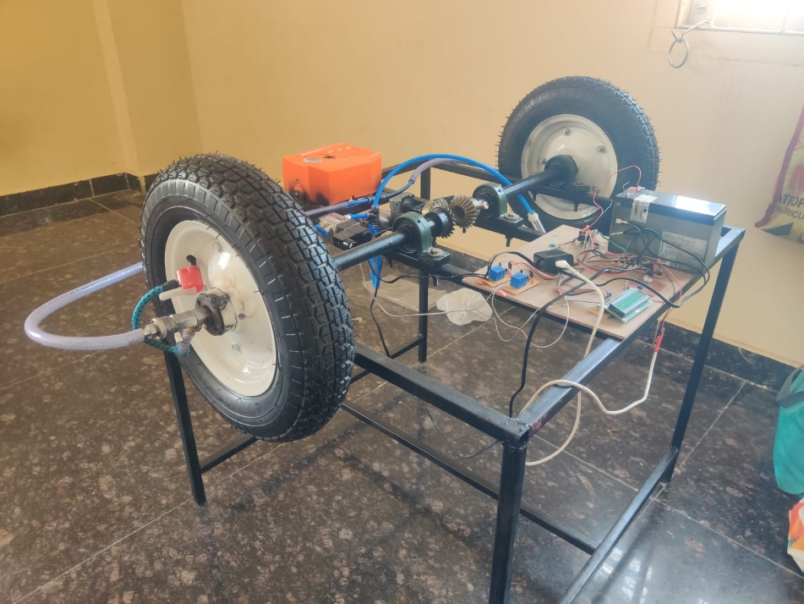
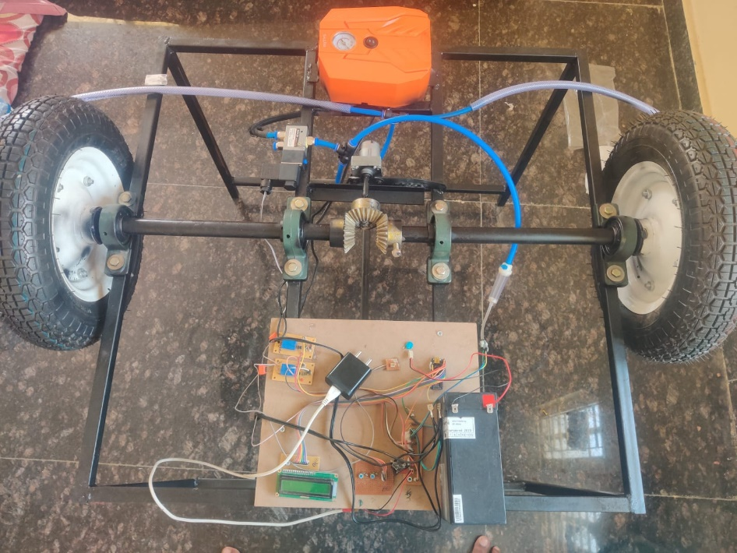

Slide 18
REFERENCES :
Vestel Elektronik Sanayi ve Ticaret A.S.,(2018-2020) ,For regulating air pressure in one or more tires of the vehicle- EP3590738A1.
Ghaffariyan M.R. (2017): Impacts of Central Tire Inflation Systems application on forest transportation – Review. J. For. Sci., 63: pp:153–160.
Chehaibi, S., M. Khelifi, A. Boujelban, K. Abrougui. 2012. Effects of tire inflation pressure and field traffic on Compaction of a sandy clay soil as measured by cone Index and permeability.
Pauras Ghag., 2022, Automatic Tire Inflation System .
Alhossein Mustafa sharif and Abdelrhyman ayman mohamed., 2022, Influences of controlling Tire inflation pressure on handling characteristics of off road vehicles in MATLAB using AS2TM soft soil tyre model.
A. Vasantharaj1, K. Krishnamoorthy2. “Tire Pressure Monitoring System Using SoC and Low Power Design”. Circuits and Systems, 2016, 7, 4085-4097 http://www.scirp.org/journal/cs ISSN Online: 2153-1293 ISSN Print: 2153-1285

